Slide 1

Wireless Networks
Authors:
Marius Popovici
Daniel Crişan
Zagham Abbas
Technical University of Cluj-Napoca
Group 3250
Cluj-Napoca, 24 Nov. 2003

Slide 2

Presentation Outline
Wireless Technology overview
The IEEE 802.11 WLAN Standards
Secure Wireless LANs
Migrating to Wireless LANs (Cutting the cord)

Slide 3
Wireless?
A wireless LAN or WLAN is a wireless local area network that uses radio waves as its carrier.
The last link with the users is wireless, to give a network connection to all users in a building or campus.
The backbone network usually uses cables

Slide 4
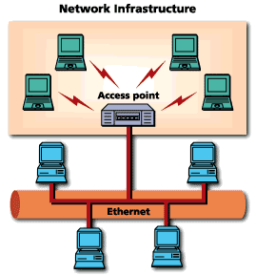
Common Topologies
The wireless LAN connects to a wired LAN
There is a need of an access point that bridges wireless LAN traffic into the wired LAN.
The access point (AP) can also act as a repeater for wireless nodes, effectively doubling the maximum possible distance between nodes.

Slide 5

Common Topologies
Complete Wireless Networks
The physical size of the network is determined by the maximum reliable propagation range of the radio signals.
Referred to as ad hoc networks
Are self-organizing networks without any centralized control
Suited for temporary situations such as meetings and conferences.

Slide 6
How do wireless LANs work?
Wireless LANs operate in almost the same way as
wired LANs, using the same networking protocols
and supporting the most of the same
applications.

Slide 7
How are WLANs Different?
They use specialized physical and data link protocols
They integrate into existing networks through access points which provide a bridging function
They let you stay connected as you roam from one coverage area to another
They have unique security considerations
They have specific interoperability requirements
They require different hardware
They offer performance that differs from wired LANs.

Slide 8
Physical and Data Link Layers
Physical Layer:
The wireless NIC takes frames of data from the link layer, scrambles the data in a predetermined way, then uses the modified data stream to modulate a radio carrier signal.
Data Link Layer:
Uses Carriers-Sense-Multiple-Access with Collision Avoidance (CSMA/CA).

Slide 9
Integration With Existing Networks
Wireless Access Points (APs) - a small device that bridges wireless traffic to your network.
Most access points bridge wireless LANs into Ethernet networks, but Token-Ring options are available as well.

Slide 10
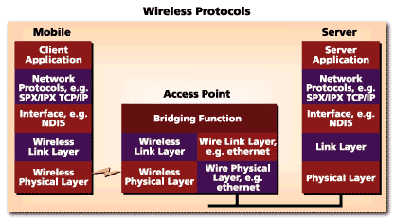
Integration With Existing Networks

Slide 11
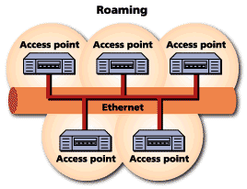
Roaming
Users maintain a continuous connection as they roam from one physical area to another
Mobile nodes automatically register with the new access point.
Methods: DHCP, Mobile IP
IEEE 802.11 standard does not
address roaming, you may need
to purchase equipment from one
vendor if your users need to roam
from one access point to another.

Slide 12
Security
In theory, spread spectrum radio signals are inherently difficult to decipher without knowing the exact hopping sequences or direct sequence codes used
The IEEE 802.11 standard specifies optional security called "Wired Equivalent Privacy" whose goal is that a wireless LAN offer privacy equivalent to that offered by a wired LAN. The standard also specifies optional authentication measures.

Slide 13
Interoperability
Before the IEEE 802.11 interoperability was based on cooperation between vendors.
IEEE 802.11 only standardizes the physical and medium access control layers.
Vendors must still work with each other to ensure their IEEE 802.11 implementations interoperate
Wireless Ethernet Compatibility Alliance (WECA) introduces the Wi-Fi Certification to ensure cross-vendor interoperability of 802.11b solutions

Slide 14
Hardware
PC Card, either with integral antenna or with external antenna/RF module.
ISA Card with external antenna connected by cable.
Handheld terminals
Access points

Slide 15
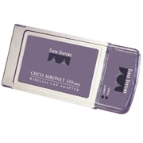
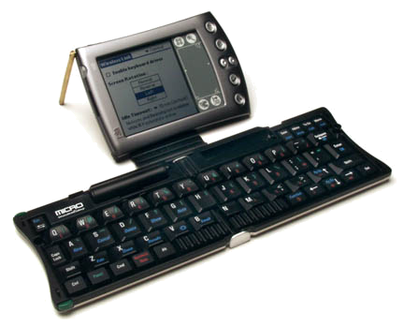
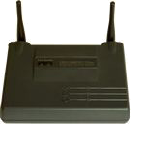
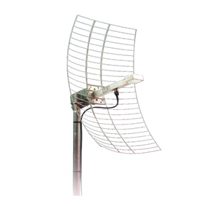
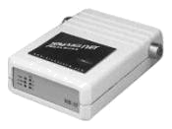
Hardware
CISCO Aironet 350 series
Wireless Handheld Terminal
Semi Parabolic Antenna
BreezeCOM AP

Slide 16
Performance
802.11a offers speeds with a theoretically maximum rate of 54Mbps in the 5 GHz band
802.11b offers speeds with a theoretically maximum rate of 11Mbps at in the 2.4 GHz spectrum band
802.11g is a new standard for data rates of up to a theoretical maximum of 54 Mbps at 2.4 GHz.

Slide 17
What is 802.11?
A family of wireless LAN (WLAN) specifications developed by a working group at the Institute of Electrical and Electronic Engineers (IEEE)
Defines standard for WLANs using the following four technologies
  Frequency Hopping Spread Spectrum (FHSS)
  Direct Sequence Spread Spectrum (DSSS)
  Infrared (IR)
  Orthogonal Frequency Division Multiplexing (OFDM)
Versions: 802.11a, 802.11b, 802.11g, 802.11e, 802.11f, 802.11i

Slide 18
802.11 - Transmission
Most wireless LAN products operate in unlicensed radio bands
  2.4 GHz is most popular
  Available in most parts of the world
  No need for user licensing
Most wireless LANs use spread-spectrum radio
  Resistant to interference, secure
  Two popular methods
    Frequency Hopping (FH)
    Direct Sequence (DS)

Slide 19
Frequency Hopping Vs. Direct Sequence
FH systems use a radio carrier that “hops” from frequency to frequency in a pattern known to both transmitter and receiver
  Easy to implement
  Resistance to noise
  Limited throughput (2-3 Mbps @ 2.4 GHz)
DS systems use a carrier that remains fixed to a specific frequency band. The data signal is spread onto a much larger range of frequencies (at a much lower power level) using a specific encoding scheme.
  Much higher throughput than FH (11 Mbps)
  Better range
  Less resistant to noise (made up for by redundancy – it transmits at least 10 fully redundant copies of the original signal at the same time)

Slide 20
802.11a
Employs Orthogonal Frequency Division Multiplexing (OFDM)
  Offers higher bandwidth than that of 802.11b, DSSS (Direct Sequence Spread Spectrum)
  802.11a MAC (Media Access Control) is same as 802.11b
Operates in the 5 GHz range

Slide 21
802.11a Advantages
Ultra-high spectrum efficiency
  5 GHz band is 300 MHz (vs. 83.5 MHz @ 2.4 GHz)
  More data can travel over a smaller amount of bandwidth
High speed
  Up to 54 Mbps
Less interference
  Fewer products using the frequency
    2.4 GHz band shared by cordless phones, microwave ovens, Bluetooth, and WLANs

Slide 22
802.11a Disadvantages
Standards and Interoperability
  Standard not accepted worldwide
  No interoperability certification available
  for 802.11a products
  Not compatible or interoperable with 802.11b
Legal issues
  License-free spectrum in 5 GHz band not
  available worldwide
Market
  Beyond LAN-LAN bridging, there is limited interest for
  5 GHz adoption

Slide 23
802.11a Disadvantages
Cost
  2.4 GHz will still has >40% cost advantage
Range
  At equivalent power, 5 GHz range will be ~50% of 2.4 GHz
Power consumption
  Higher data rates and increased signal require more power
    OFDM is less power-efficient then DSSS

Slide 24
802.11a Applications
Building-to-building connections
Video, audio conferencing/streaming video,
and audio
Large file transfers, such as engineering
CAD drawings
Faster Web access and browsing
High worker density or high throughput scenarios
  Numerous PCs running graphics-intensive applications

Slide 25
802.11a Vs. 802.11b
802.11a vs. 802.11b | 802.11a | 802.11b
Raw data rates | Up to 54 Mbps (54, 48, 36, 24,18, 12 and 6 Mbps) | Up to 11 Mbps (11, 5.5, 2, and 1 Mbps)
Range | 50 Meters | 100 Meters
Bandwidth | UNII and ISM (5 GHz range) | ISM (2.4000— 2.4835 GHz range)
Modulation | OFDM technology | DSSS technology

Slide 26
802.11g
802.11g is a high-speed extension to 802.11b
  Compatible with 802.11b
  High speed up to 54 Mbps
  2.4 GHz (vs. 802.11a, 5 GHz)
  Using ODFM for backward compatibility
  Adaptive Rate Shifting

Slide 27
802.11g Advantages
Provides higher speeds and higher capacity requirements for applications
  Wireless Public Access
Compatible with existing 802.11b standard
Leverages Worldwide spectrum availability
in 2.4 GHz
Likely to be less costly than 5 GHz alternatives
Provides easy migration for current users of 802.11b WLANs
  Delivers backward support for existing 802.11b products
Provides path to even higher speeds in the future

Slide 28
802.11e Introduces Quality of Service
Also know as P802.11 TGe
Purpose:
  To enhance the 802.11 Medium Access
  Control (MAC) to improve and manage
  Quality of Service (QoS)
Cannot be supported in current chip design
Requires new radio chips
  Can do basic QoS in MAC layer

Slide 29
802.11f – Inter Access Point Protocol
Also know as P802.11 TGf
Purpose:
  To develop a set of requirements for Inter-Access Point Protocol (IAPP), including operational and management aspects

Slide 30
802.11b Security Features
Wired Equivalent Privacy (WEP) – A protocol to protect link-level data during wireless transmission between clients and access points.
Services:
  Authentication: provides access control to the network by denying access to client stations that fail to authenticate properly.
  Confidentiality: intends to prevent information compromise from casual eavesdropping
  Integrity: prevents messages from being modified while in transit between the wireless client and the access point.

Slide 31
Authentication
Means:
Based on cryptography
Non-cryptographic
Both are identity-based verification mechanisms (devices request access based on the SSID – Service Set Identifier of the wireless network).

Slide 32
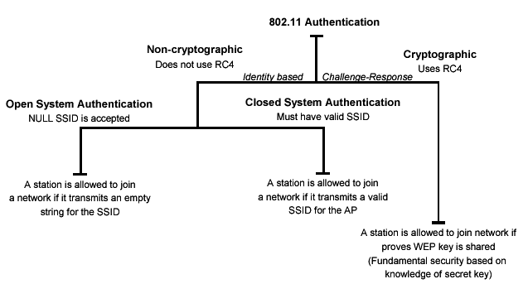
Authentication
Authentication techniques

Slide 33
Privacy
Cryptographic techniques
WEP Uses RC4 symmetric key, stream cipher algorithm to generate a pseudo random data sequence. The stream is XORed with the data to be transmitted
Key sizes: 40bits to 128bits
Unfortunately, recent attacks have shown that the WEP approach for privacy is vulnerable to certain attack regardless of key size

Slide 34
Data Integrity
Data integrity is ensured by a simple encrypted version of CRC (Cyclic Redundant Check)
Also vulnerable to some attacks

Slide 35
Security Problems
Security features in Wireless products are frequently not enabled.
Use of static WEP keys (keys are in use for a very long time). WEP does not provide key management.
Cryptographic keys are short.
No user authentication occurs – only devices are authenticated. A stolen device can access the network.
Identity based systems are vulnerable.
Packet integrity is poor.

Slide 36
Other WLAN Security Mechanisms
3Com Dynamic Security Link
CISCO LEAP - Lightweight Extensible Authentication Protocol
IEEE 802.1x – Port-Based Network Access Control
RADIUS Authentication Support
EAP-MD5
EAP-TLS
EAP-TTLS
PEAP - Protected EAP
TKIP - Temporal Key Integrity Protocol
IEEE 802.11i

Slide 37
WLAN Migration – Cutting The Cord
Essential Questions
Choosing the Right Technology
Data Rates
Access Point Placement and Power
Antenna Selection and Placement
Connecting to the Wired LAN
The Site Survey

Slide 38
Essential Questions
Why is the organization considering wireless? Allows to clearly define requirements of the WLAN -> development plan
How many users require mobility?
What are the applications that will run over the WLAN? Helps to determine bandwidth requirements, a criteria to choose between available technologies. Wireless is a shared medium, not switched!!!

Slide 39
Choose the right technology
Usually IEEE 802.11b or 802.11a
802.11b offers interoperability (WECA Wi-Fi Certification Program)
802.11a offers higher data rates (up to 54 mbps) -> higher throughput per user. Limited interoperability.

Slide 40
Data rates
Data rates affect range
802.11b 1 to 11 Mbps in 4 increments
802.11a 6 to 54 Mbps in 7 increments
The minimum data rate must be determined at design time
Selecting only the highest data rate will require a greater number of APs to cover a specific area
Compromise between data rates and overall system cost

Slide 41
Access Point Placement and Power
Typically – mounted at ceiling height.
Between 15 and 25 feet (4.5m to 8m)
The greater the height, the greater the difficulty to get power to the unit. Solution: consider devices that can be powered using CAT5 Ethernet cable (CISCO Aironet 1200 Series).
Access points have internal or external antennas

Slide 42
Antenna Selection and Placement
Permanently attached.
Remote antennas connected using an antenna cable.
Coax cable used for RF has a high signal loss, should not be mounted more than a 1 or 2 meters away from the device.
Placement: consider building construction, ceiling height, obstacles, and aesthetics. Different materials (cement, steel) have different radio propagation characteristics.

Slide 43
Connecting to the Wired LAN
Consider user mobility
If users move between subnets, there are challenges to consider.
OSes like Windows XP and 2000, Linux support DHCP to obtain the new IP address for the subnet. Certain applications such as VPN will fail.
Solution: access points in a roaming area are on the same segment.

Slide 44
The Site Survey
Helps define the coverage areas, data rates, the precise placement of access point.
Gather information: diagramming the coverage area and measuring the signal strength, SNR (signal to noise ratio), RF interference levels

Slide 45
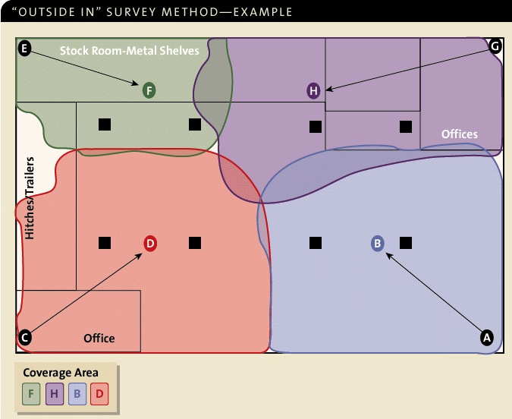
Site Survey

Slide 46
Vendor Information
CISCO Systems Wireless http://www.cisco.com/warp/public/44/jump/wireless.shtml
3Com Wireless http://www.3com.com/products/en_US/prodlist.jsp?tab=cat&pathtype=purchase&cat=13&selcat=Wireless+Products
Breeze Wireless Communications
http://www.breezecom.com
Lucent Technologies
http://www.wavelan.com
Symbol Technologies http://www.symbol.com

Slide 47
References
CISCO Packet Magazine, 2nd Quarter 2002 http://www.cisco.com/en/US/about/ac123/ac114/ac173/ac168/about_cisco_packet_issue_home.html
3Com University – Wireless LANs A Technology Overview www.3com.com/3comu
National Institute of Standards and Technology Wireless Network Security http://csrc.nist.gov/publications/drafts/draft-sp800-48.pdf

